Slide 1

Name: Jayachandiran V
NMid:au513521114007
Department: Mechanical Engineering
College:AMCET

Slide 2


Slide 3


Slide 4


Slide 5


Slide 6


Slide 7
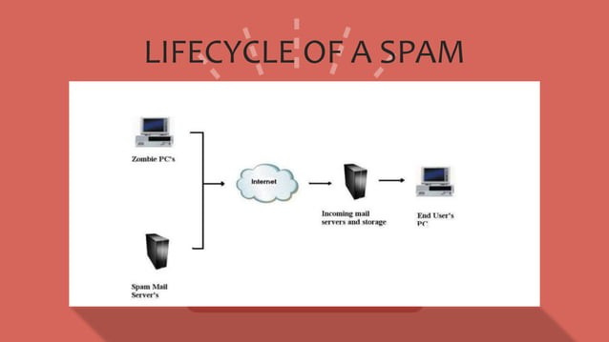

Slide 8


Slide 9
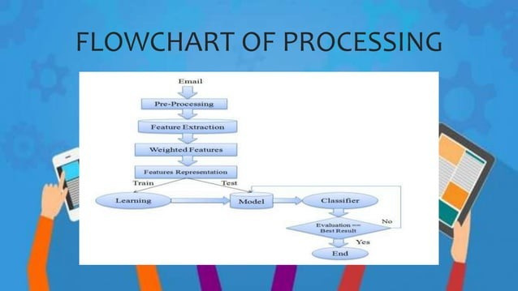

Slide 10


Slide 11


Slide 12


